Slide 1
Market Basket Analysis with Python – Target
Presented by: Alpana Prajapati
Data Science Project
Tools used : Python, Python libraries: Pandas, Seaborn, Matplotlib, Scikit-Learn

Slide 2
Project Overview
Target : Leading Global e-commerse platform
Huge customer & product data
Goal: Improve personalization & Sales

Slide 3
Business Problem
Which products are bought together?
Customer behaviour across demographics
Customer segmentation
Improve recommendations & loyalty

Slide 4
Objective
Analyze Customer behaviour and Product Recommendation Report
Apply market Basket Analysis techniques
Perform clustering & segmentation
Generate actionable insights for personalized product recommendations, promotional strategies, and inventory optimization.

Slide 5
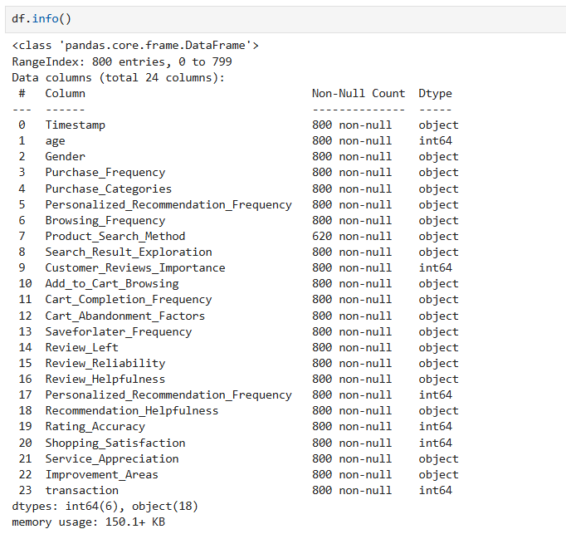
Dataset Overview
Customer Demographics
Purchase Frequency
Browsing behaviour
Satisfaction & Reviews
Recommendation helpfulness

Slide 6
Tasks Performed and Their Outcomes
Data cleaning:
Removed duplicates
Handled missing values
Standardised categories
converted data types.

Slide 7
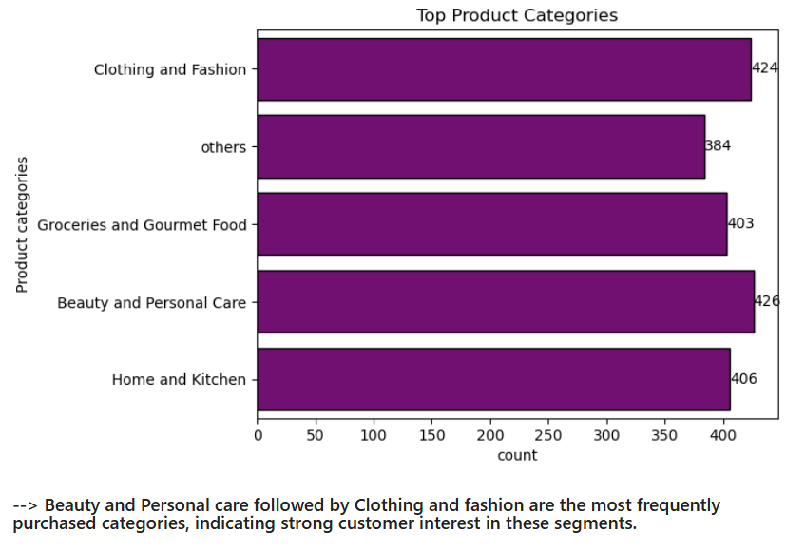
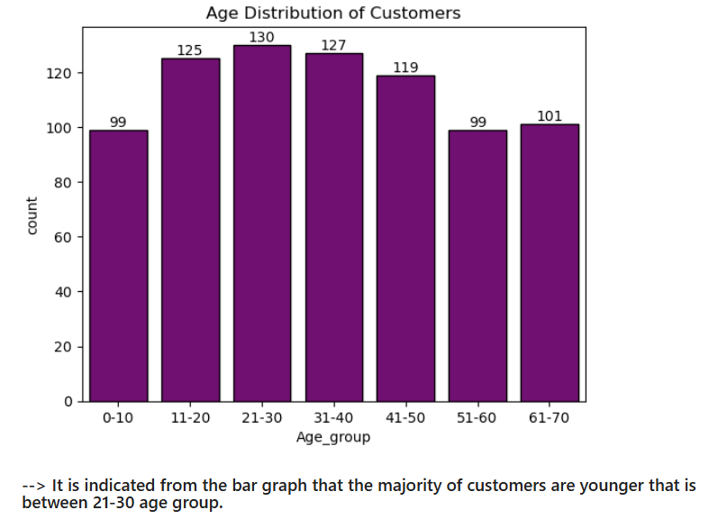
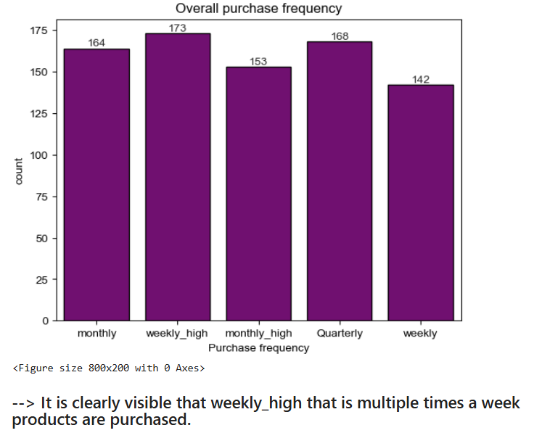
Descriptive Analysis
Descriptive Analysis:
Age Distribution
Purchase frequency
Popular categories

Slide 8
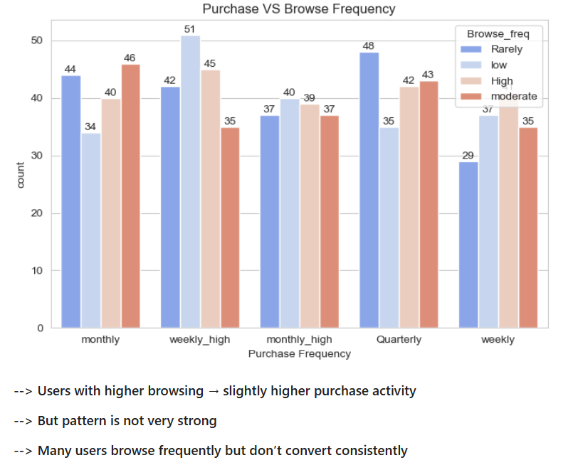
Customer Behavior Insights:
Most users are frequent browsers
Cart abandon reasons
Popular browsing methods

Slide 9
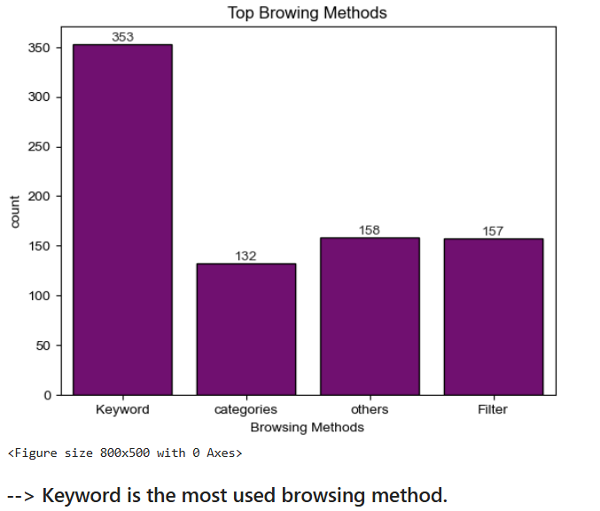
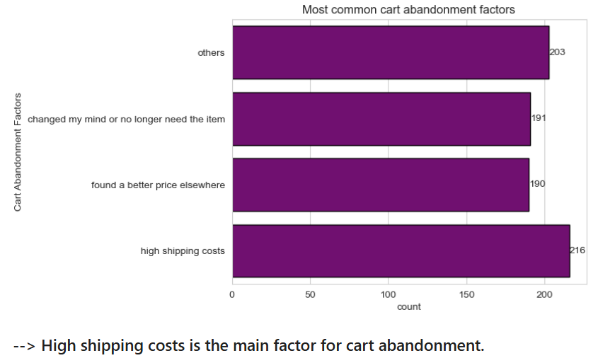

Slide 10
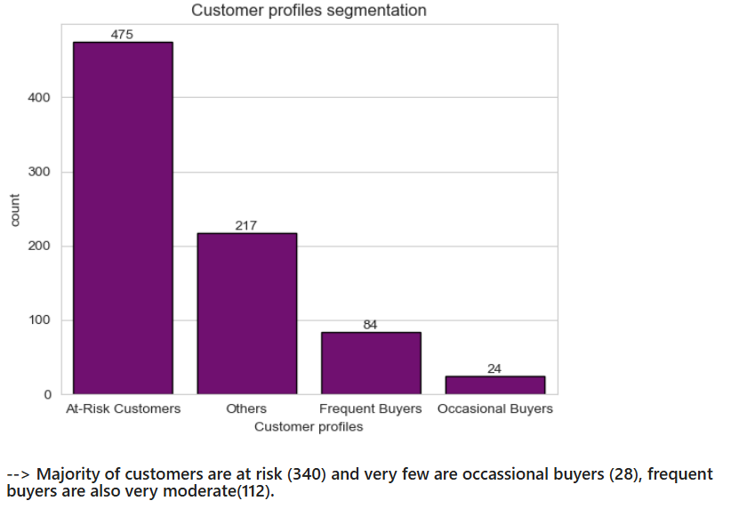
Customer Segmentation
Frequent Buyers
Occasional Shoppers
At-Risk Customers

Slide 11
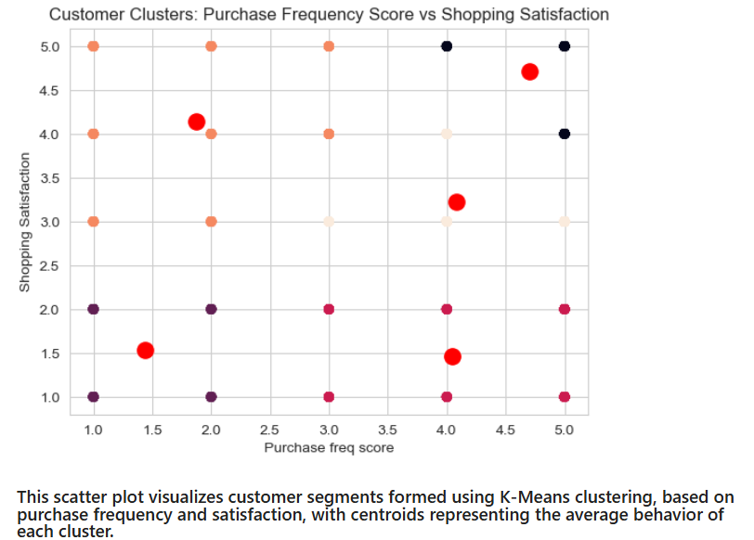
Clustering (K-Means)
Used K-Means Clustering
Grouped based on behaviour
Identified patterns
Cluster profiling revealed distinct customer segments based on purchase behavior and satisfaction levels, helping identify loyal customers, at-risk users, and potential growth segments.

Slide 12
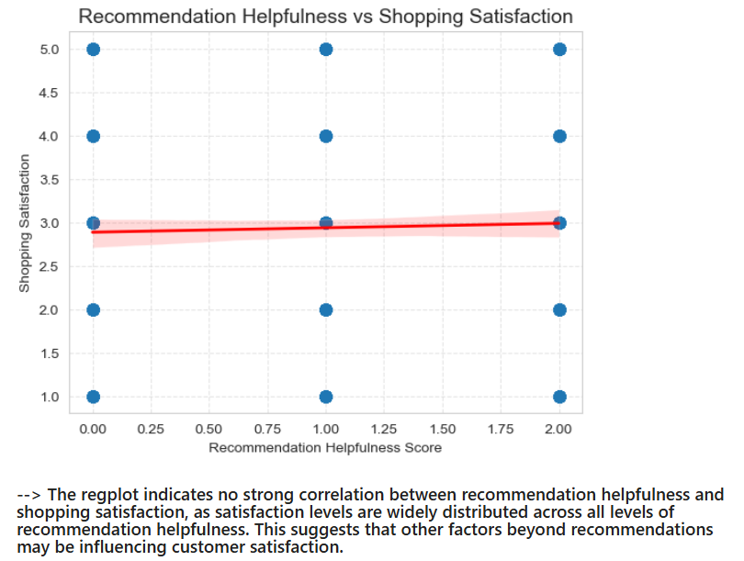
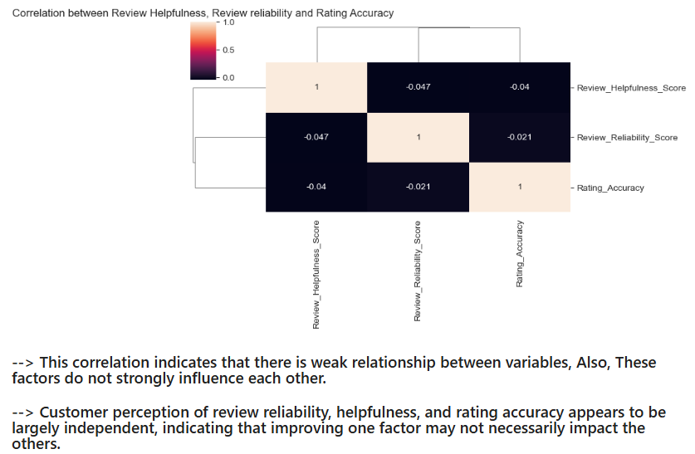
Recommendation Insights
Recommendations improve satisfaction
Review reliability impacts trust
Personalized suggestions increase engagement

Slide 13
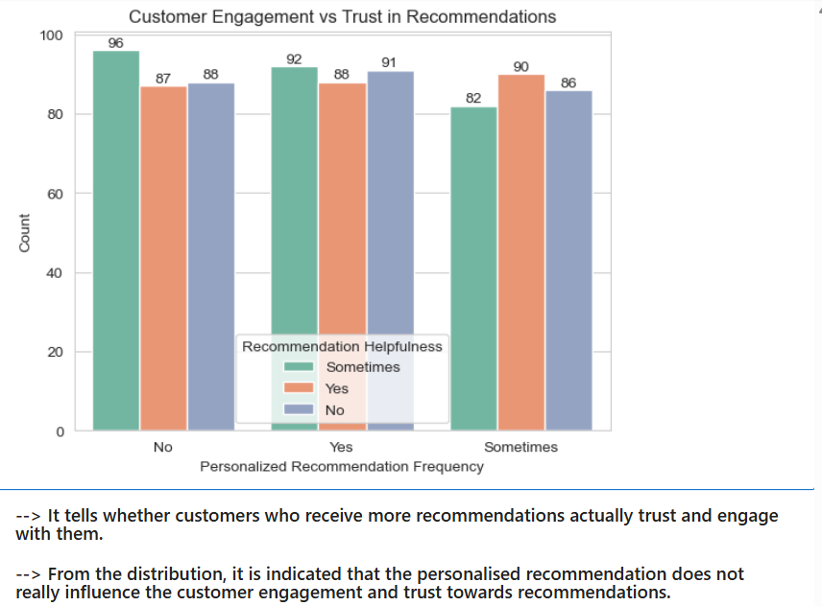
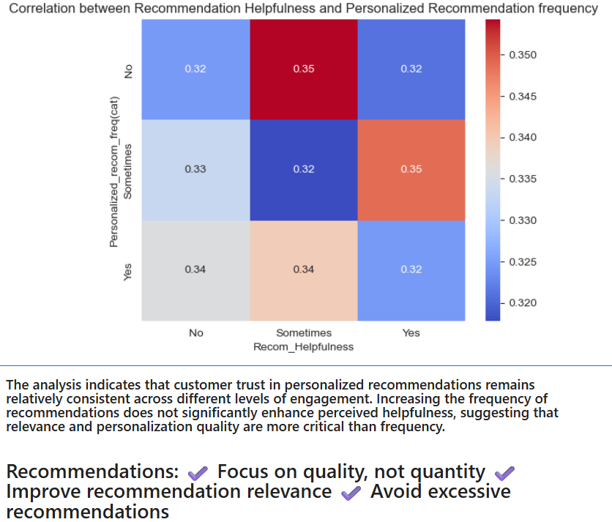

Slide 14
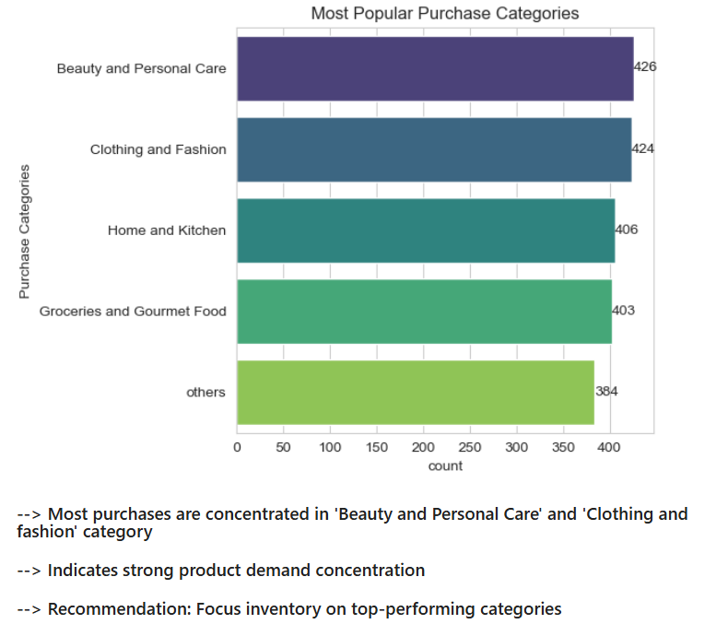
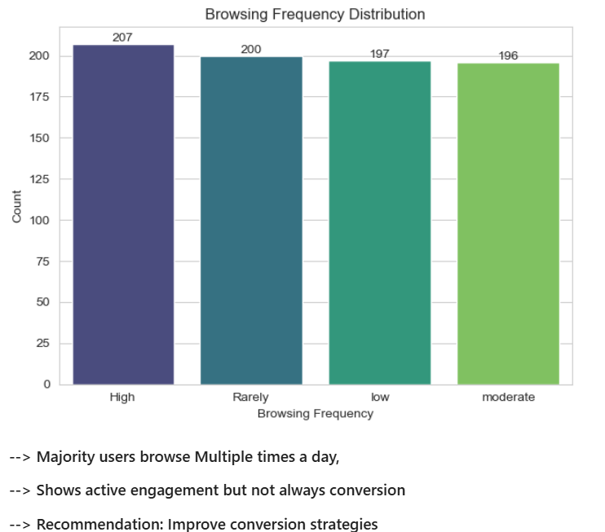
Visualizations
Bar chart (Purchase Categories, Browsing frequency)

Slide 15
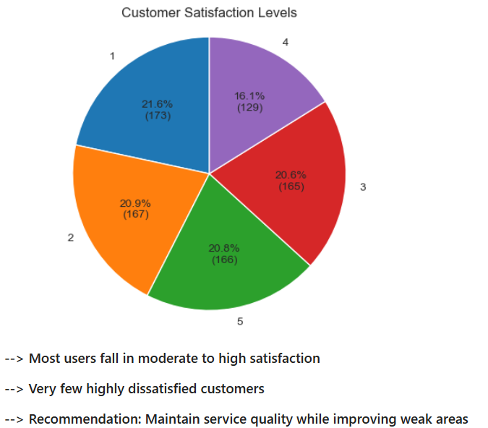
Pie chart (Satisfaction levels)

Slide 16
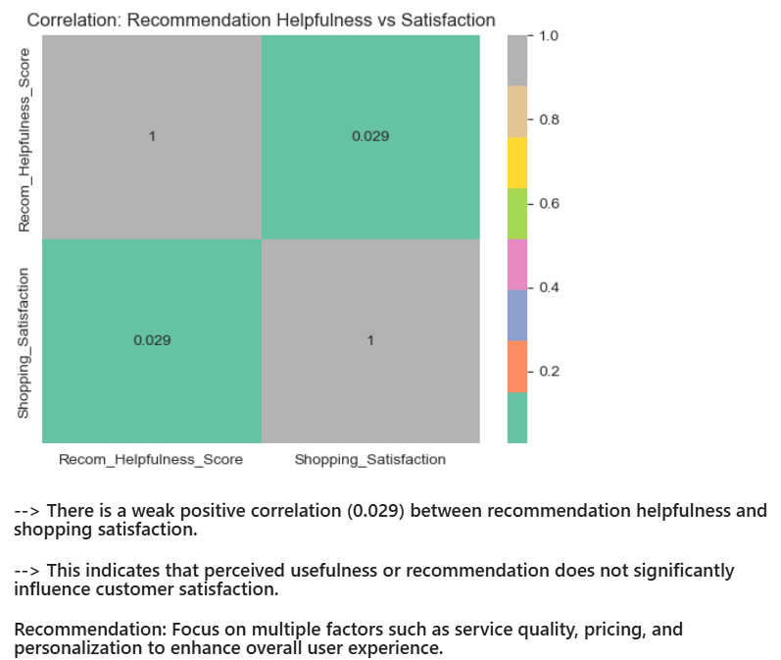
Correlation between recommendation usefulness and satisfaction

Slide 17
Key Findings
High satisfaction = higher purchases
High At-Risk Customers
Majority users browse Multiple times a day
Recommendations influence decisions: Customers don’t find recommendations significantly helpful → low correlation
Certain products are frequently bought together: Beauty & personal care and Clothing & Fashion
The analysis indicates that customer trust in personalized recommendations remains relatively consistent across different levels of engagement.

Slide 18
Business Recommendations
Improve recommendation system
Target frequent buyers
Reduce cart abandonment
Optimize inventory on top performing categories
From Customer satisfaction analysis: Maintain service quality while improving weak areas
Focus on multiple factors such as service quality, pricing, and personalization to enhance overall user experience.

Slide 19
Conclusion
Data-Driven insights achieved
Improved customer understanding
Supports better decision making

Slide 20


